Slide 1
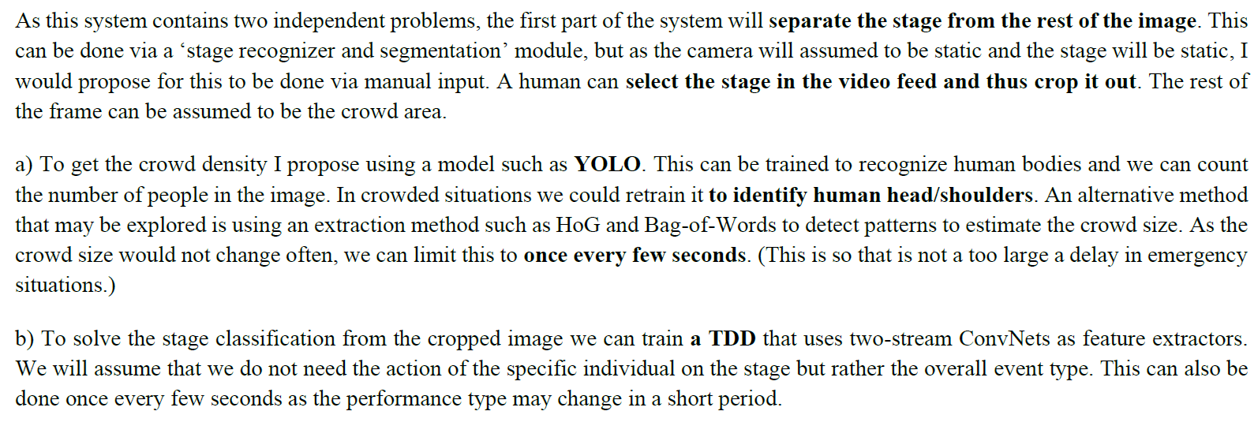
Sample answer 1 (provided by students)

Slide 2
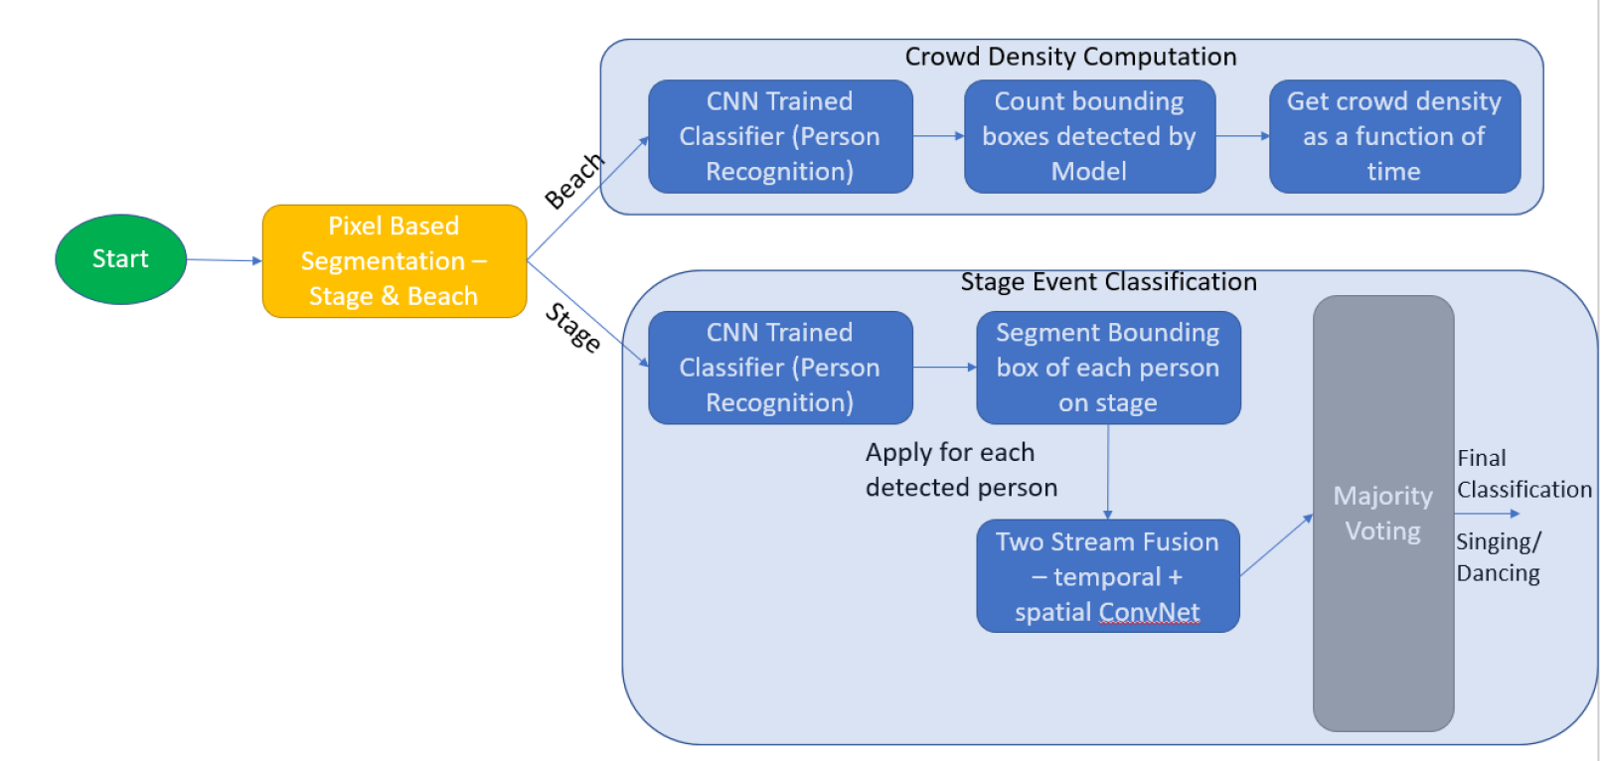
Sample answer 2 (provided by students)

